Slide 1






Welcome!
Sim Tech Symposium

Slide 2
House-keeping
Fire alarms and exits
Bathrooms
Refreshments
Mobile phones – silent please

Slide 3
Introductions
Who are we?
Who are you?
- what’s your role?
- where do you work?
- what manikins / kit do you use?

Slide 4
Schedule
Time | Event
9:00 – 9:15 | Registration & Coffee
9:15 – 9:30 | House-keeping, introductions and objectives for the day. Show & tell?
9:30 – 9:45 | Sim centre tour
9:45 – 10:30 | Practical demonstrations: Gerry’s (SimMan 3G) IM pad George’s (1 year old Guamard) IO drain Chest drain kit
10:30 – 10:45 | Coffee
10:45 – 12:00 | Practical demonstrations: Bypassing Gerry’s drug recognition system HAL’s ventilator compliant fake lungs Various quick fixes Show & tell?
12:00 – 12:45 | Lunch
12:45 – 14:30 | Networking exercise: Quick overview of networking in simulation Excersice involving ad-hoc network and remote desktop Examples of how we implement these tools Software problems & solutions: Overcoming quiet voice of built in manikin speakers Our experience with Aurasma Other useful apps
14:30 – 14:45 | Coffee
14:45 – 16:00 | Audio – visual discussion: What we use in our centre and in-situ. What do you use? Backing up our data Anymore show & tell? Engaging with candidates – desensitising, familiarising & encouraging Useful resources – Evernote, simulation forums, Youtube…

Slide 5
Meet the Family & Demos of Solutions

Slide 6
Networking
- overview of the essentials
Access points and routers
Wireless ad-hoc networks
IP addresses (192.168.1.1) – static, dynamic & reserved
cmd > ipconfig; ping

Slide 7
Networking
- overview of the essentials
Network connection properties
Subnet mask and ports
Google is your friend ☺
Remote desktop

Slide 8
Networking
- remote desktop examples
Preparing debrief playback (genesis)
Make real-time adjustments to a monitor PC
Bespoke applications – Cath lab scenario

Slide 9
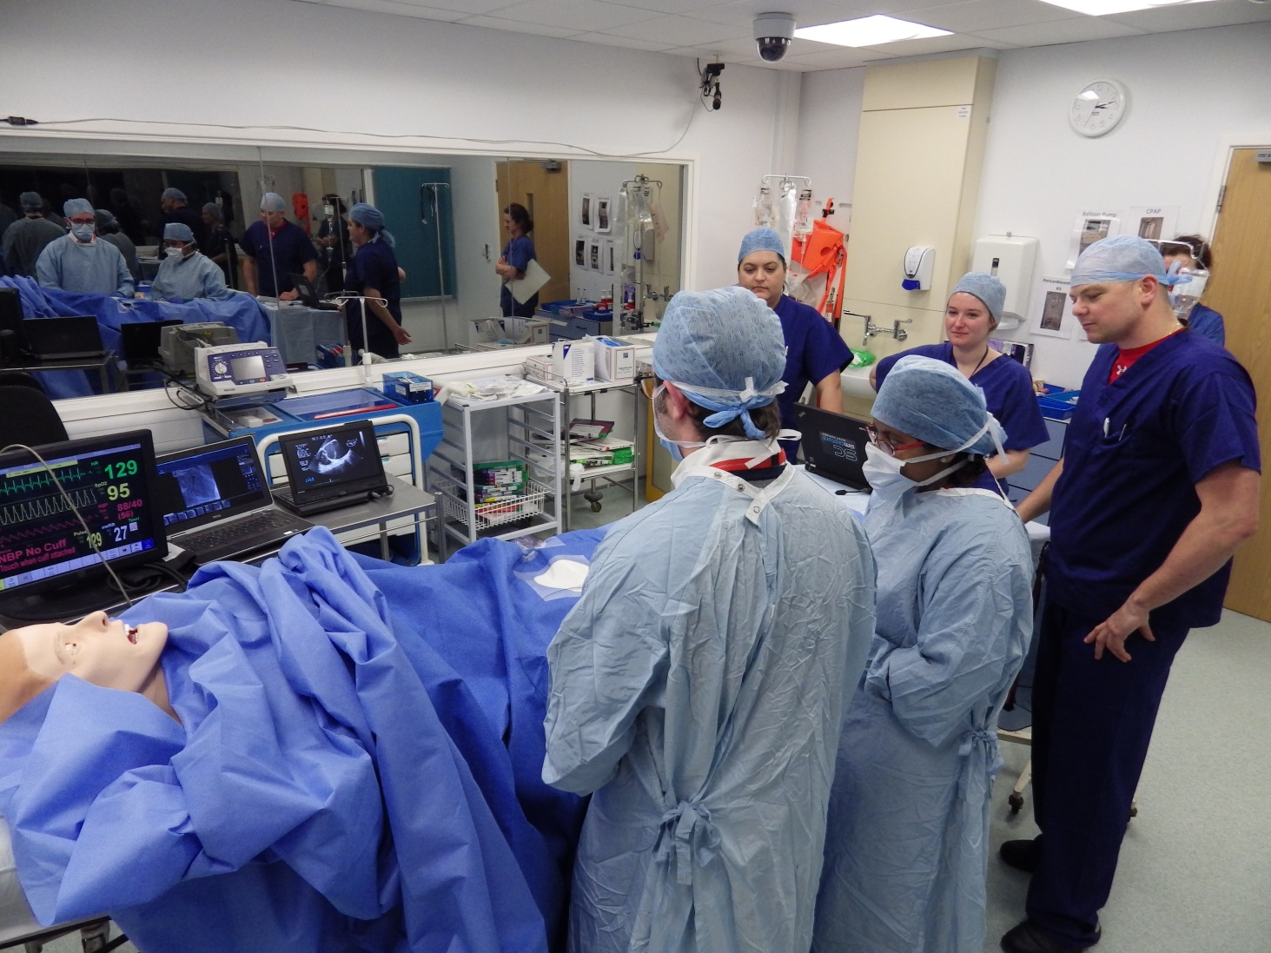
Networking
- remote desktop examples

Slide 10
Networking
- exercise
1. Acquire a tablet PC
2. Create an ad-hoc network with your neighbour
3. Install the remote desktop software, UltraVNC
4. Take control of your neighbour’s computer and hold them to ransom

Slide 11
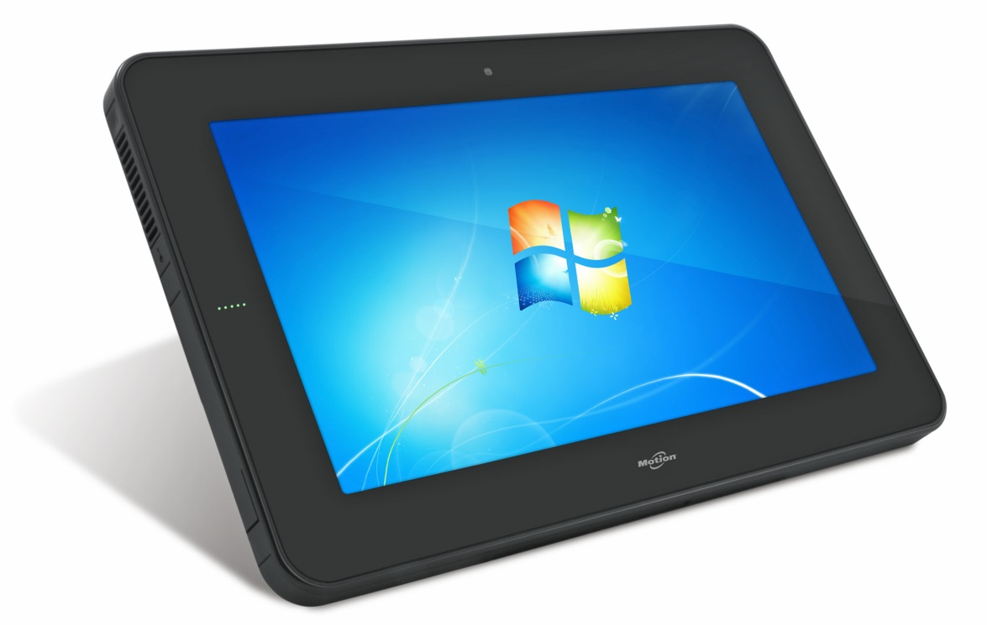
Networking
- exercise
1. Acquire a tablet PC
2. Create an ad-hoc network with your neighbour
3. Install the remote desktop software, UltraVNC
4. Take control of your neighbour’s computer and hold them to ransom

Slide 12
Networking
- exercise
1. Acquire a tablet PC
2. Create an ad-hoc network with your neighbour
3. Install the remote desktop software, UltraVNC
4. Take control of your neighbour’s computer and hold them to ransom

Slide 13
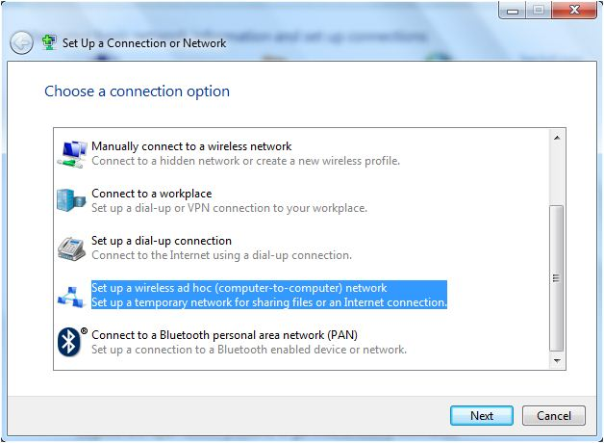
Networking
- exercise
1. Acquire a tablet PC
2. Create an ad-hoc network with your neighbour
3. Install the remote desktop software, UltraVNC
4. Take control of your neighbour’s computer and hold them to ransom

Slide 14
Networking
- exercise
2. Create an ad-hoc network with your neighbour
1. Acquire a tablet PC
3. Install the remote desktop software, UltraVNC
4. Take control of your neighbour’s computer and hold them to ransom

Slide 15
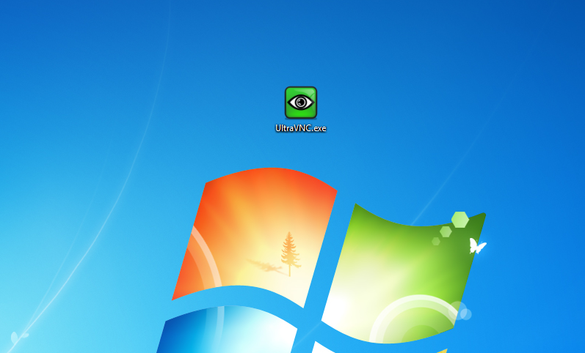

Networking
- exercise
1. Acquire a tablet PC
2. Create an ad-hoc network with your neighbour
3. Install the remote desktop software, UltraVNC
4. Take control of your neighbour’s computer and hold them to ransom

Slide 16
Networking
- exercise
3. Install the remote desktop software, UltraVNC
1. Acquire a tablet PC
2. Create an ad-hoc network with your neighbour
4. Take control of your neighbour’s computer and hold them to ransom

Slide 17
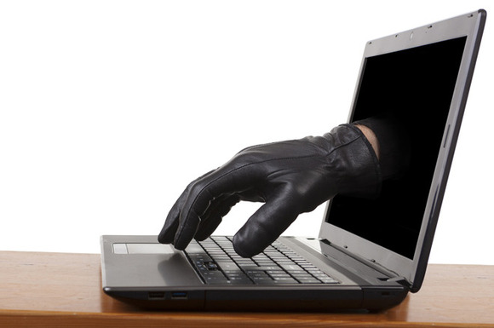
Networking
- exercise
1. Acquire a tablet PC
2. Create an ad-hoc network with your neighbour
3. Install the remote desktop software, UltraVNC
4. Take control of your neighbour’s computer and hold them to ransom!

Slide 18
Software
- for simulation. Simware?
Augmented reality – Aurasma / QR codes
Viber
Evernote

Slide 19

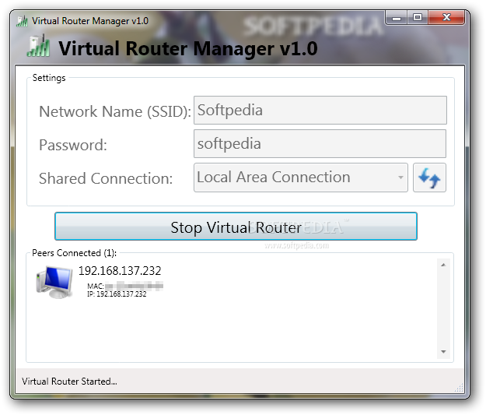
Audio - Visual
- manikin voice

Slide 20


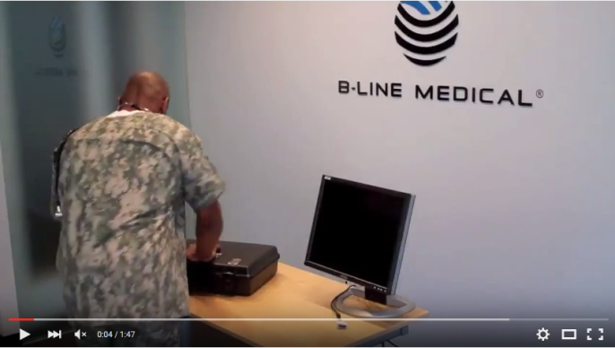
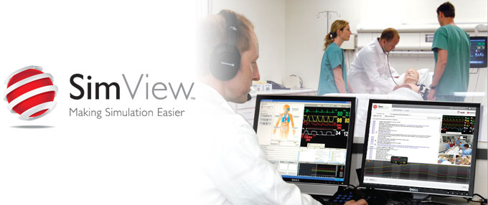

Audio - Visual
- recording & playback

Slide 21
Engaging candidates
Introducing kit
Desensitising
Encouraging

Slide 22

Useful resources
Sugru website
Evernote website
Drivers for ELO touchscreen on generic device
SUN network
Healthy simulation
Behind the sim curtain
Networking tutorials
Youtube links for wounds
Viber website
Aurasma website
Soundwire website
Virtual Router website
B-Line website
SimView website

